Slide 1
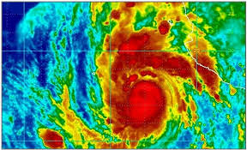
WEATHER
&
CLIMATE
(II)

Slide 2
WEATHER: the state of the atmosphere at a particular time & place. It refers to the meteorological phenomena that affect a relatively small area for a short period of time and can change quickly.
CLIMATE: The state of the atmosphere in a particular region over a long period of time.

Slide 3
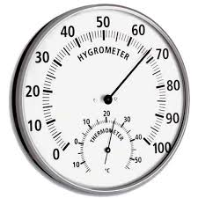
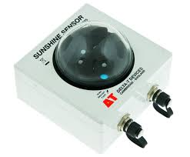
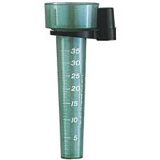
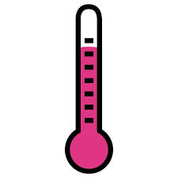
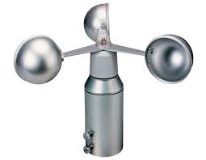
WEATHER STATIONS
Sunshine Sensor
Hygrometer: Humidity
Pluviometer: Rain
Anemometer: Wind
Thermometer

Slide 4


CLIMATE
FLORA
FAUNA

Slide 5
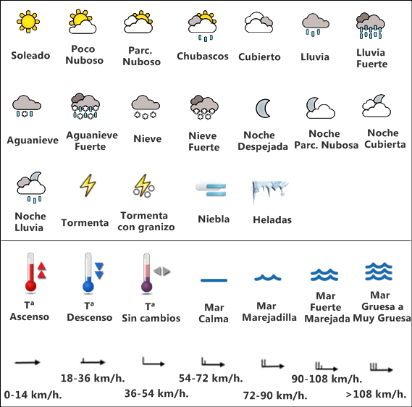
Forecast symbols

Slide 6
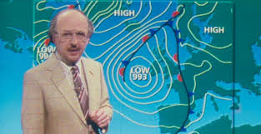
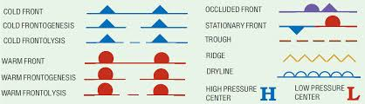

Slide 7
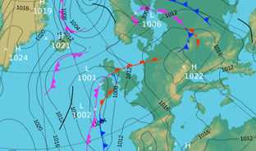
CLIMATE ELEMENTS
TEMPERATURE
PRECIPITATION
PRESSURE
WIND
RELATIVE HUMIDITY

Slide 8
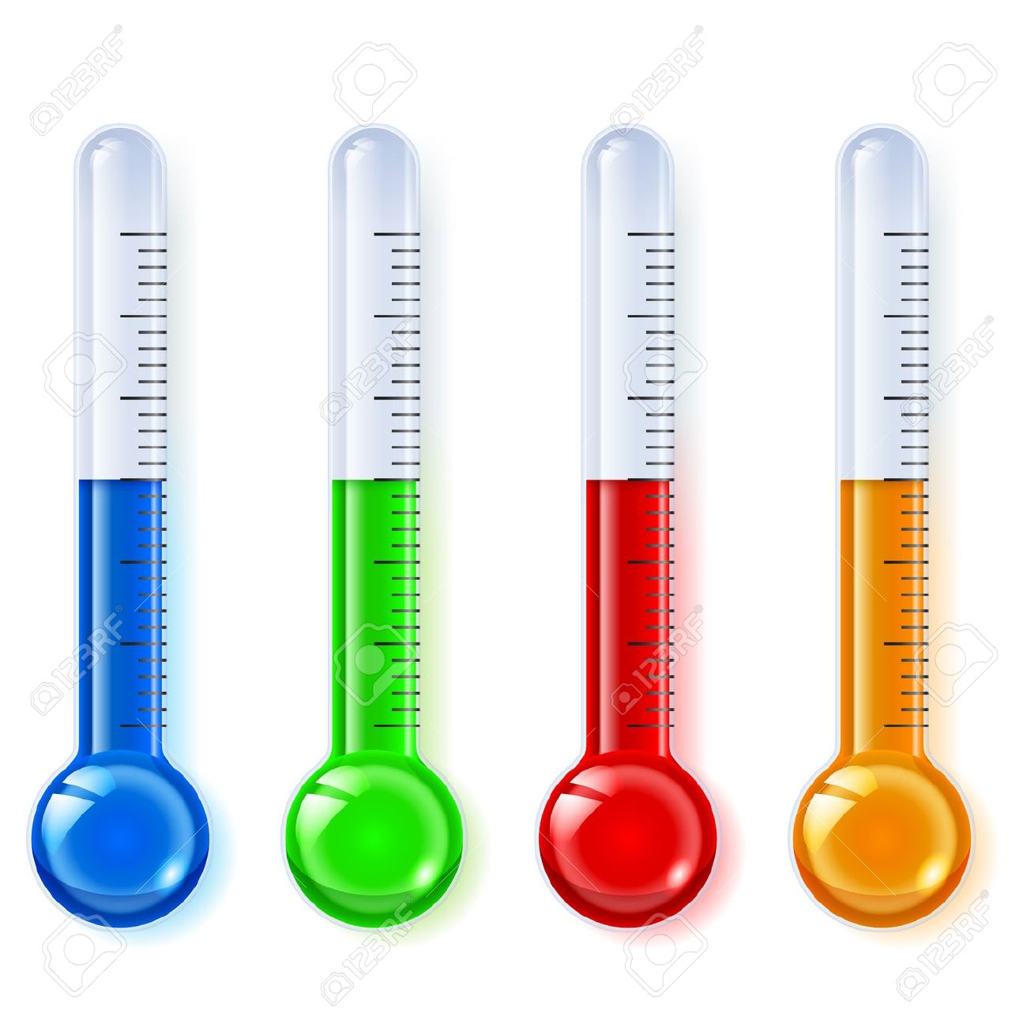
TEMPERATURE
Amount of heat in the environment.
Measured by a thermometer.
Expressed in degrees Celsius or Farenheit
There are three climate zones according to temperature:
  Tropical
  Temperate
  Polar

Slide 9

PRECIPITATION
Definition: It’s water contained in clouds that falls to the Earth’s surface.
Measured by a pluviometer in litres or millimetres by square metre.
In the form of rain, snow, hail.

Slide 10
Types of Rain
Convectional rainfall
Relief or Orographic rainfall
Frontal rainfall

Slide 11
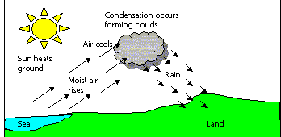
Convectional rainfall
Why? The Sun heats the Earth and the air around. The air rises and condenses. Heavy rain occurs.
Where? Equatorial regions with temperate climate in Summer

Slide 12
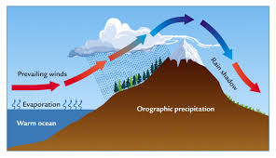
Relief or Orographic rainfall
Why? Air rises over mountains. As it’s passing over the mountain, it cools and forms rain. On the other slope, the clouds are lighter without the weight of the water. The air warms as it descends. There is little or no rain there.

Slide 13
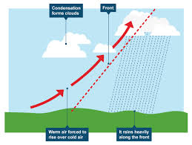
Frontal rainfall
FRONT: area where two masses of air (one cold and one warm) meet.
Cold Front:
A cold air mass pushes into a warm air mass.
Consequences: short periods of heavy rain.

Slide 14
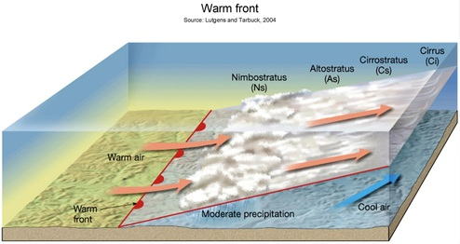
Warm front: The cold air mass is heavier and moves under the warm air mass. The warm air rises slowly, it cools and then it condenses.
Consequences: long periods of light rain.

Slide 15
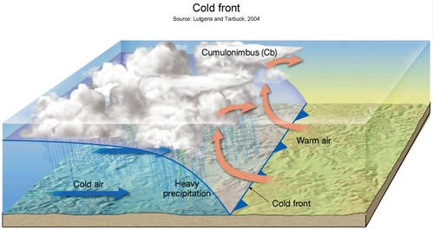
Warm vs Cold

Slide 16
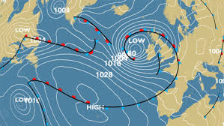
LOW PRESSURE or DEPRESSION or CYCLONE
The air is warm and moist. The air is lighter and rises and brings rain.
It brings unstable weather.
It is represented by close isobars.
Pressure is lower than normal (Normal point of pressure at sea level: 1013mbar).
HIGH PRESSURE OR ANTICYCLONE
The cold air is heavier and descends.
The cold dry air brings stable weather with no rain.
It is represented by distant isobars.
Pressure is higher than normal.

Slide 17
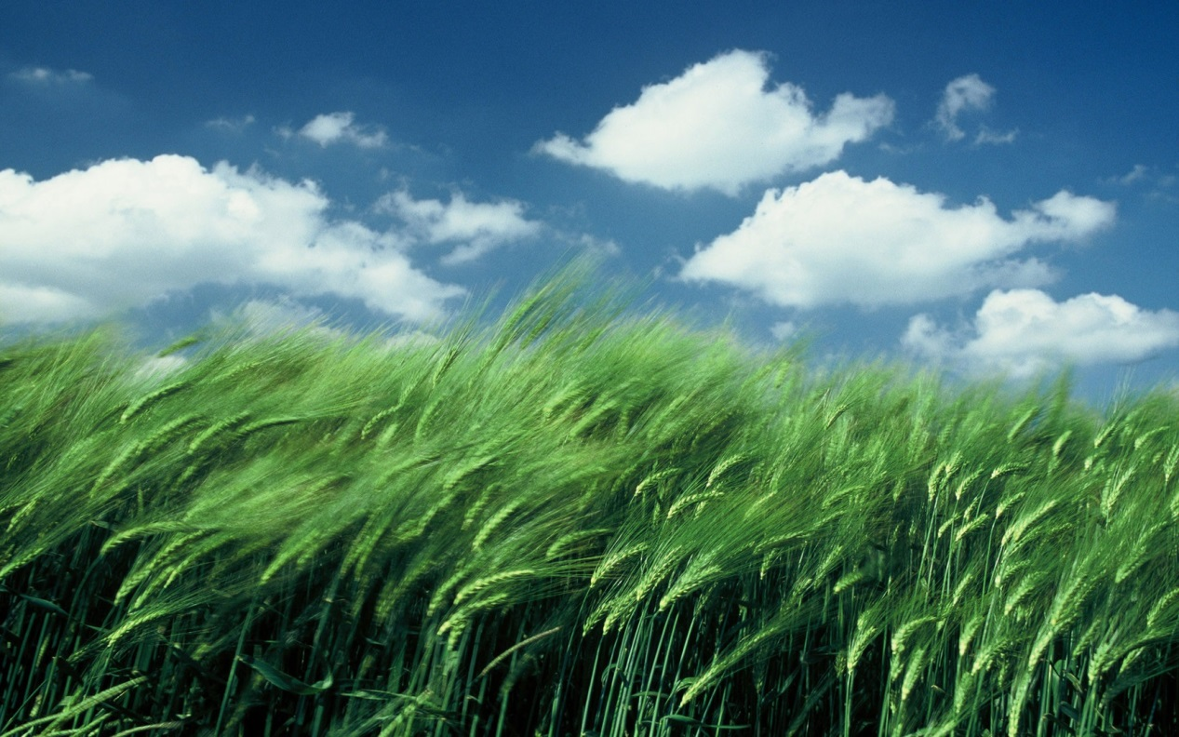
WIND
It is air that moves from from areas of high pressure to areas of low pressure due to the difference in atmospheric pressure.
It’s measured by an anemometer in km/h or m/s.

Slide 18
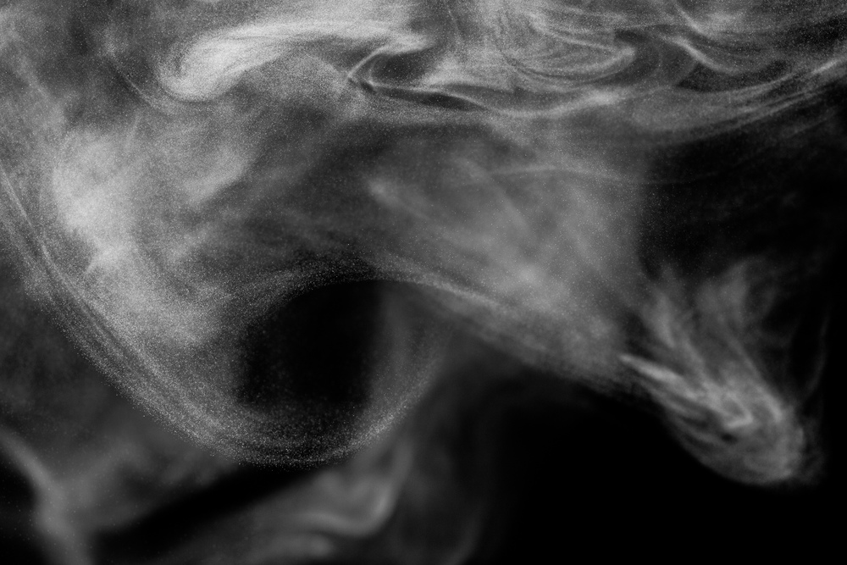
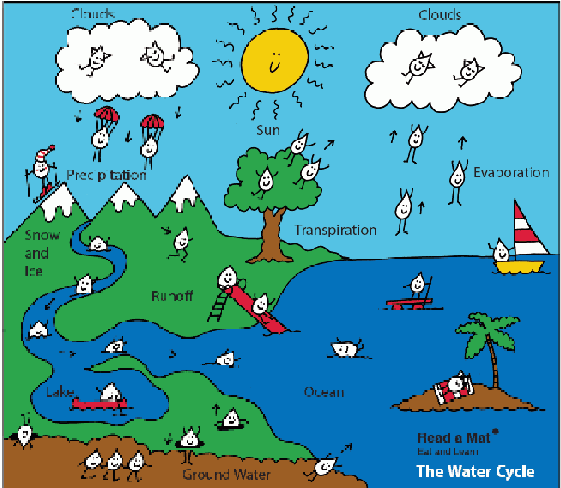
Relative humidity
Quantity of water vapour in the atmosphere

Slide 19
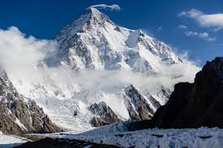
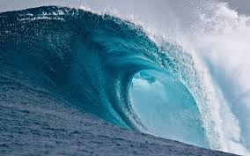
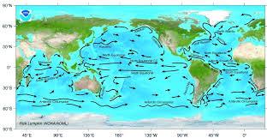
Climate factors
RELIEF: altitude / latitude
      PROXIMITY OF THE SEA
OCEAN CURRENTS

Slide 20
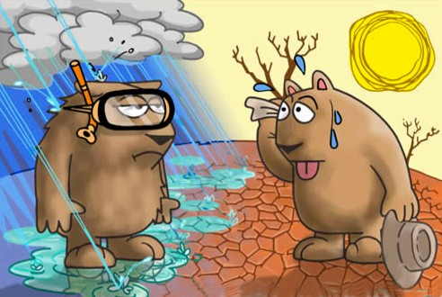
climates

Slide 21
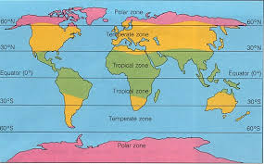
CLIMATE ZONES

Slide 22
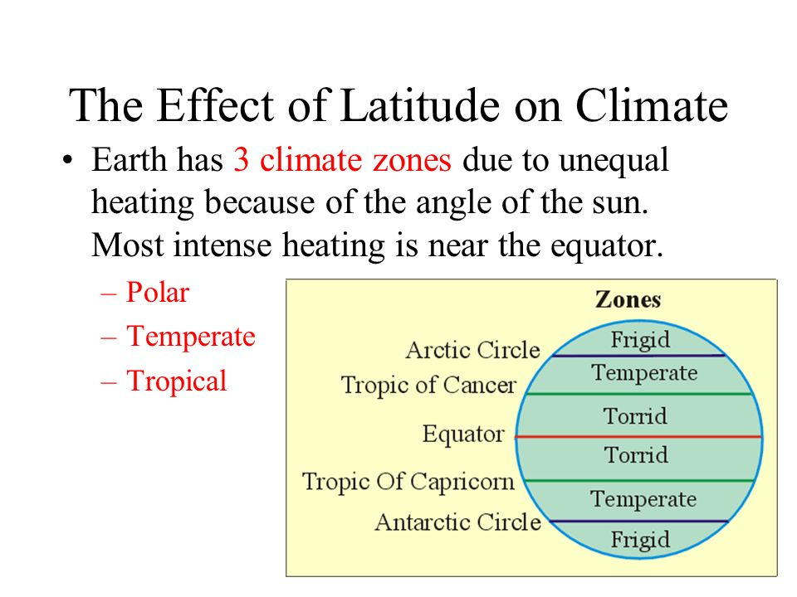

Slide 23
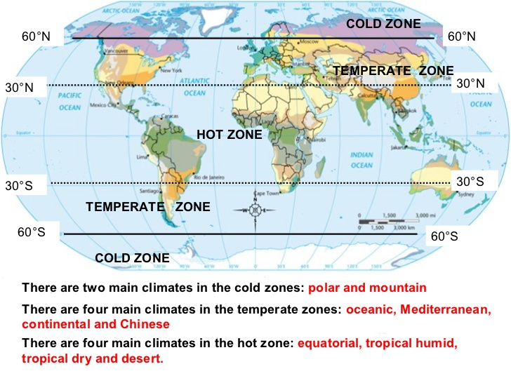

Slide 24
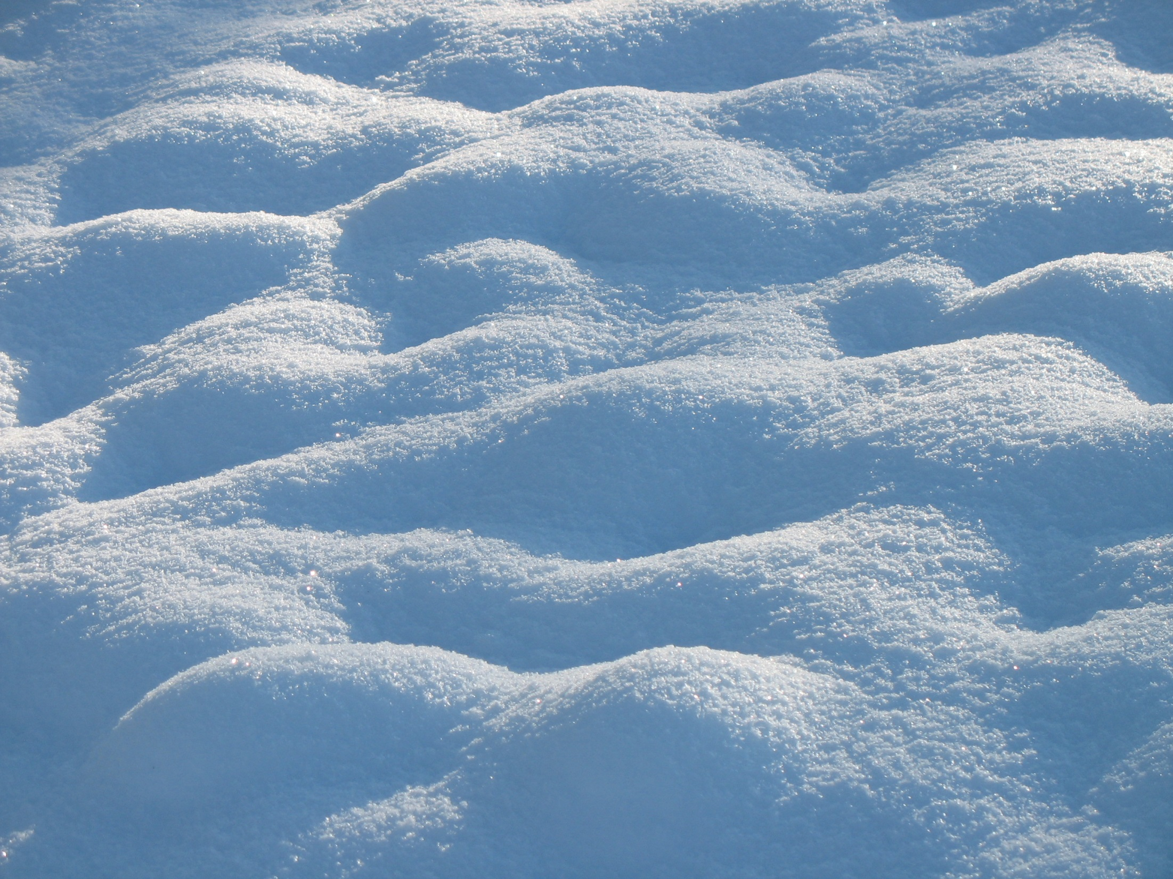
COLD CLIMATES
POLAR CLIMATE
ALPINE CLIMATE

Slide 25
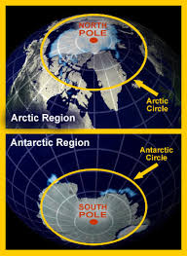
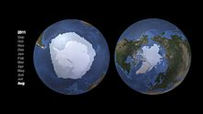
1. Polar climate
Between the two polar circles and the poles.
Include permanently frozen regions, such as Antarctica. (Angle of the Sun’s rays)
Little precipitation

Slide 26
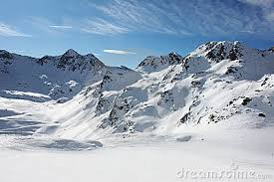
2. Alpine Climate
Decrease in temperature with altitude (on high ranges of mountains)
A lot of precipitation (mainly snow)

Slide 27
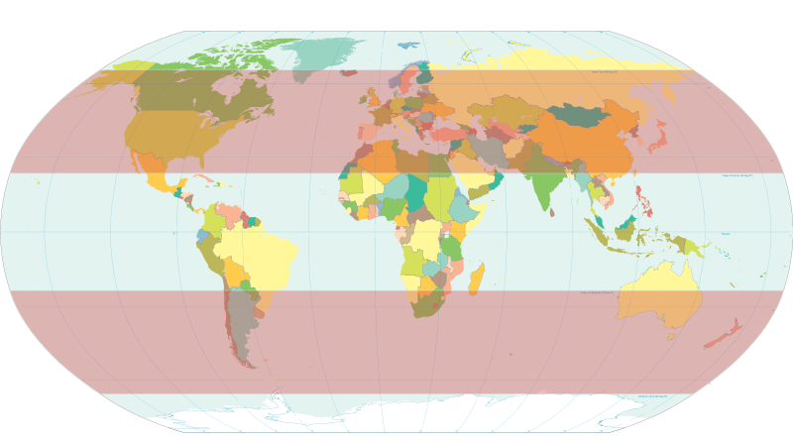
TEMPERATE CLIMATES
Located between the Tropic of Cancer and the Artic Circle in the Northern Hemisphere and the Tropic of Capricorn and the Antartic Circle in the Southern Hemisphere.
Avrge. annual temperature: 0 - 20 C.
Different seasons. Dramatic differences between summer and winter.

Slide 28
MEDITERRANEAN CLIMATE
SUB-TROPICAL CLIMATE
MARITINE CLIMATE
CONTINENTAL CLIMATE

Slide 29
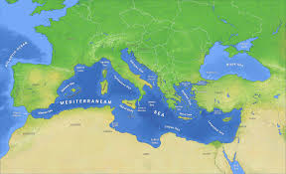
1. MEDITERRANEAN CLIMATE
Temperature is mild in winter and hot in summer
Abundant precipitation i n spring and autumn.

Slide 30
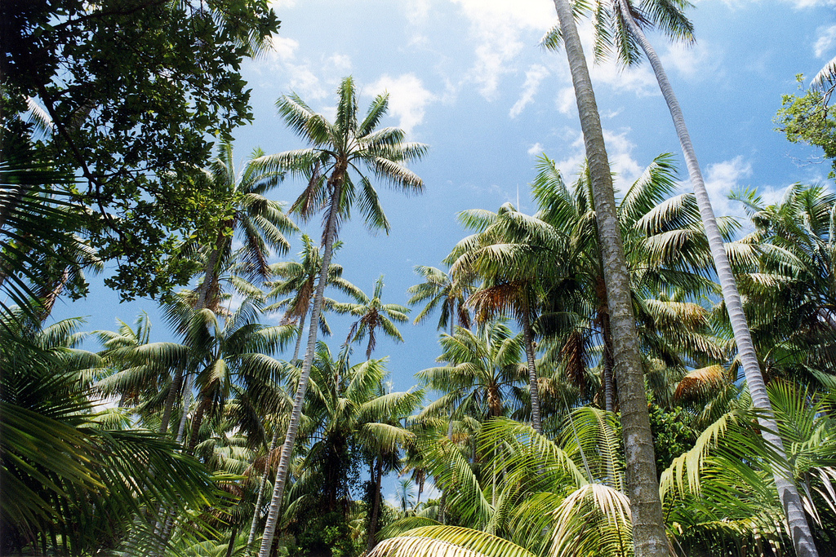
2. SUB-TROPICAL CLIMATE
Similar to Mediterranean Climate
Lots of rain in summer
Similar to Mediterranean Climate
Lots of rain in summer

Slide 31

3. MARITINE CLIMATE
Mild temperatures
Abundant precipitation all year, especially in winter (North of Spain, north of France, England, Germany etc.)

Slide 32
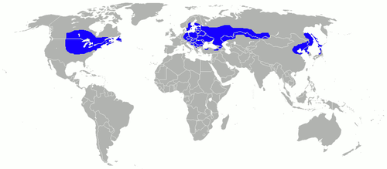
4. CONTINENTAL CLIMATE
Strong contrasts in temperature with very cold winters and very hot summers
Moderate precipitation, mostly in summer
Intense cold spells with snow in winter

Slide 33

HOT CLIMATES
Between the Tropic of Cancer, the Equator and the Tropic of Capricorn
Avrge. annual temperature: 20⁰ C.
TYPES:
- 1. TROPICAL CLIMATES
- 2. EQUATORIAL CLIMATES
- 3. MONSOON CLIMATE

Slide 34
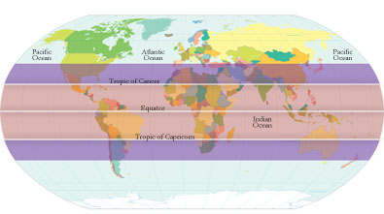
1. TROPICAL CLIMATE
Temperature is very high.
There are two seasons: A rainy season in summer and a dry season in winter.

Slide 35
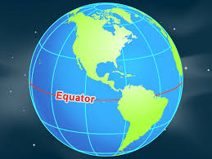
2. EQUATORIAL CLIMATE
Consistent: No seasons.
Always hot.
It rains all year.
Near the Equator

Slide 36
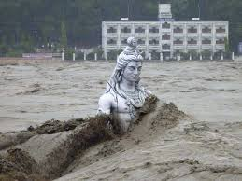
3. MONSOON CLIMATE
In summer:
- The Monsoon blows from the sea to the continent.
- This creates strong rain.
In winter:
  - The Monsoon blows from the continent to the sea.
  - This brings dry weather.

Slide 37
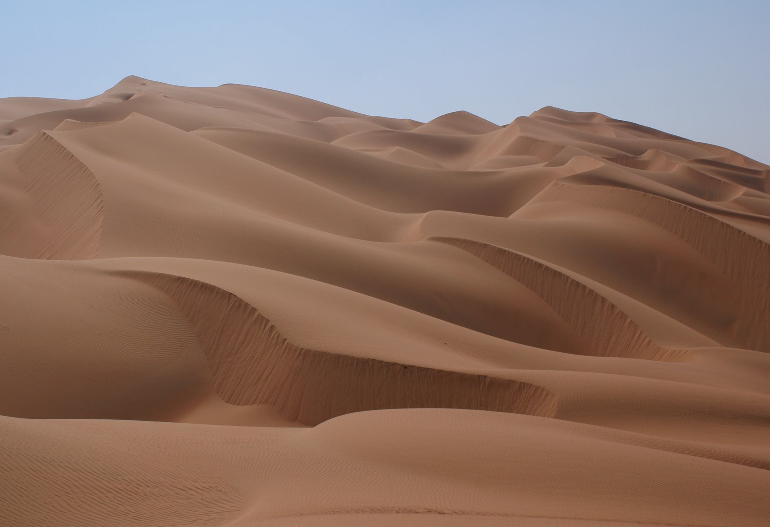
DESERT CLIMATES
Less than 100 mm of precipitation annually
Types of desert:
- Hot desert (The Sahara)
- Coastal desert (The Atacama, Chile)
- Continental desert (The Gobi, China-Mongolia)
- Frozen desert (Antarctica)

Slide 38
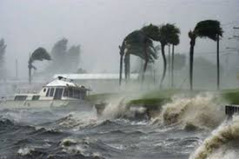
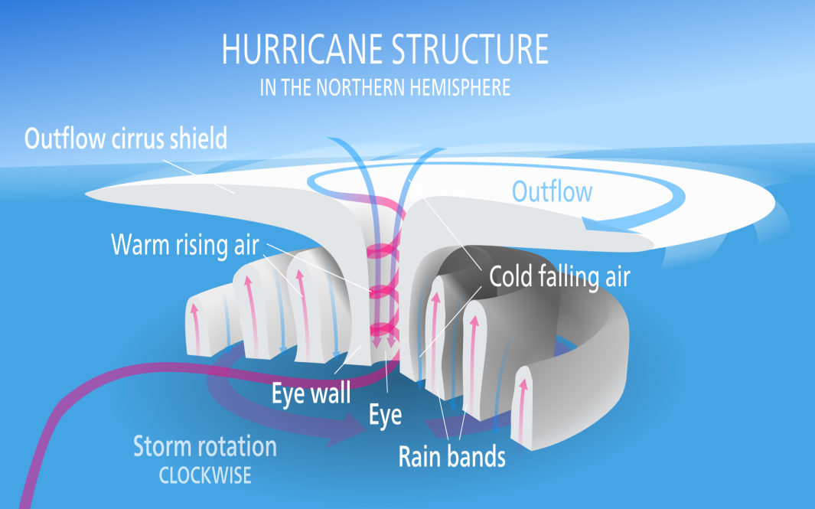
WEATHER HAZARDS
HURRICANES:
Centres of low pressure with strong winds that spiral at high speed. Consequences: huge waves, heavy flooding. (Hurricane Katrina)
In the Caribbean Sea and Southeast Asia: typhoons

Slide 39
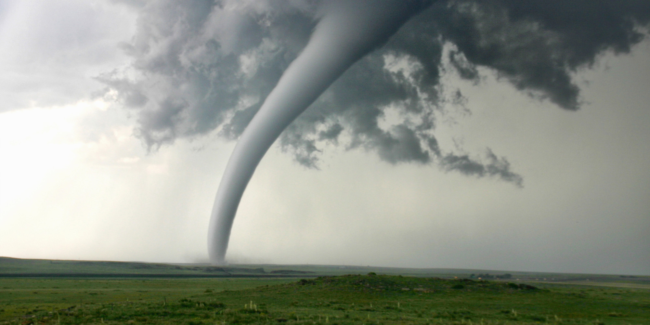
TORNADOS:
Centres of low pressure, smaller than hurricanes, but much more intense.
Formed from clouds that adopt the shape of a funnel.
In the USA in spring and summer

Slide 40
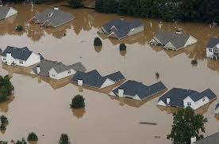
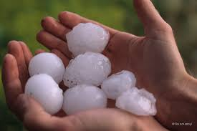
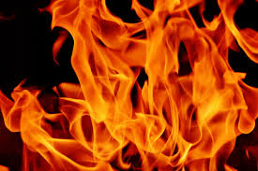
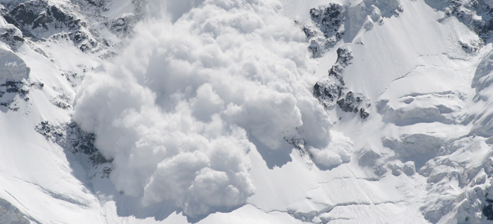
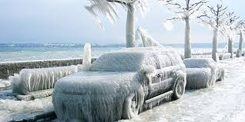
TORRENTIAL RAIN (floods, etc)
EXTREMELY HIGH/LOW TEMPERATURE (fire, death, etc.)
HAIL (crops, property affected)
HEAVY SNOWFALL (avalanches)

